Slide 1
Make gaussian realisation from the camb power spectra for kappa, I and cross and use the hp.symfast? To give us a map of these, apply mask and then do power spectrum again to compare with data results
Add a couple of slides for motivation at the beginning
Fix the bias term – growth integral in terms of a and making sure its b +delta b
Changing the 353 545 plot to scale up 353
Look at the noise stuff in the email from the map man
Fitting theory to data plots – UNITS
Remember word to describe edges of cib mask
Change all lensed cmb to cmb lensing
Notes:
Cross correlating because we expect to have too much dust in cib auto and so the correlation will remove this and leave cib
Actually think we are removing too much cib

Slide 2
Constraining Primordial Non-Gaussianity with CMB Lensing and Large Scale Structure
Anna Lawrence
15/3/19

Slide 5
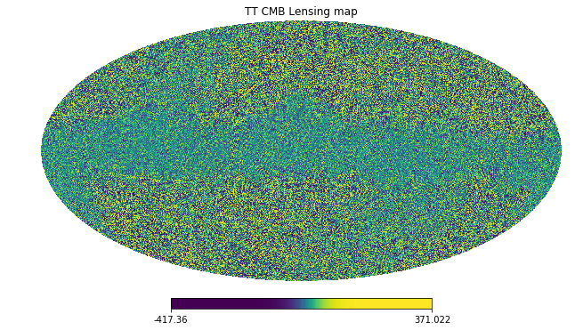
Estimated CMB lensing convergence from temperature only
COM_Lensing_4096_R3.00/TT/dat_klm.fits

Slide 6
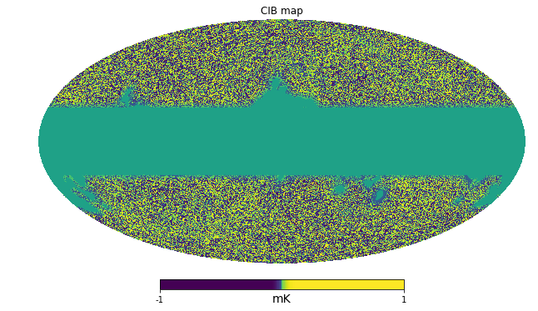
The Cosmic Infrared Background
CIB emission map at 545 GHz from GNILC

Slide 7
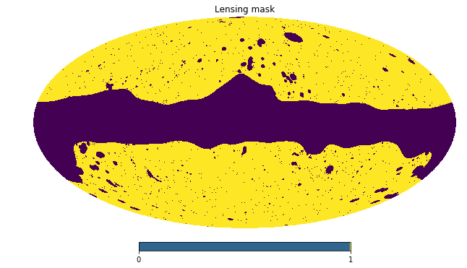
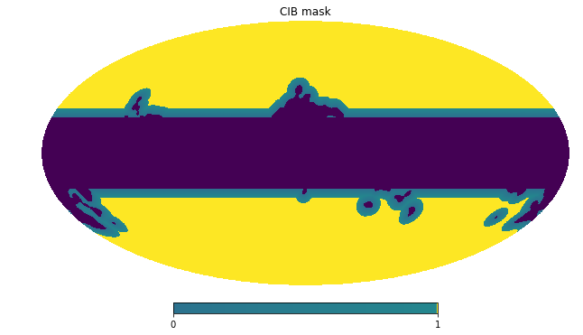
Masks
COM_Lensing_4096_R3.00/mask.fits.gz
mask_cib.fits.gz

Slide 8
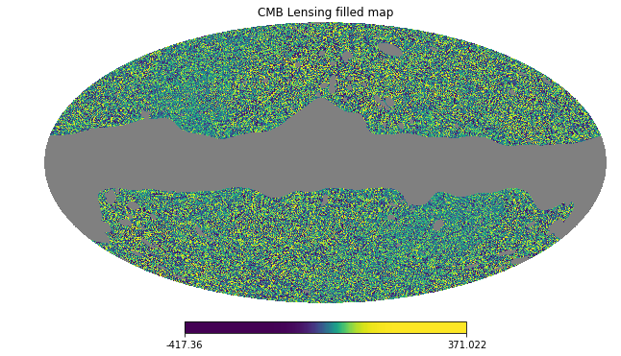
The Cosmic Microwave Background lensing convergence map with mask applied

Slide 9
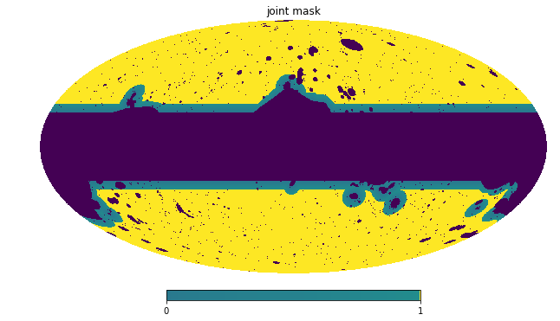
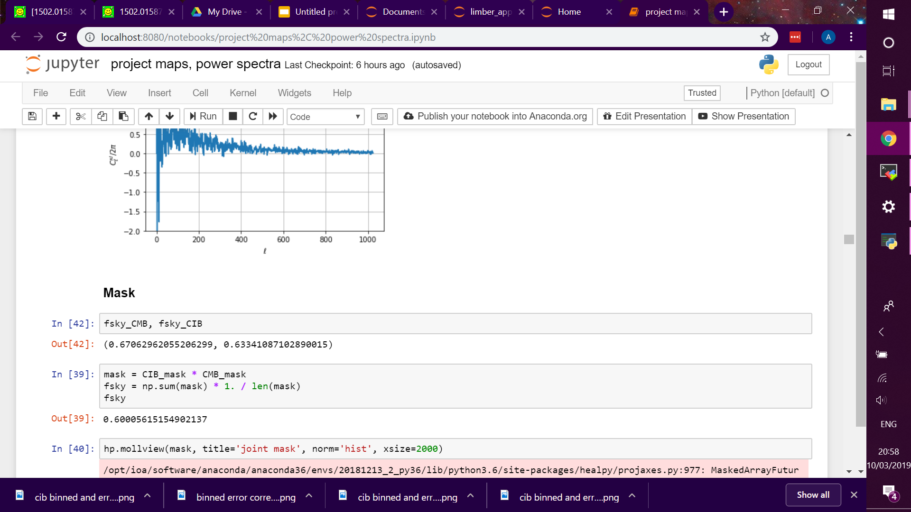
Sky Fraction
Fraction of the sky that is common to both CIB and Lensed CMB maps.

Slide 10
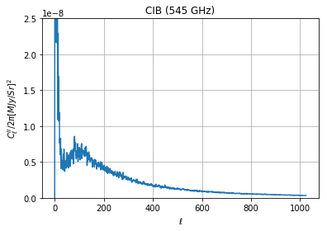
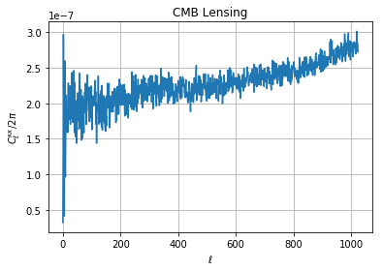
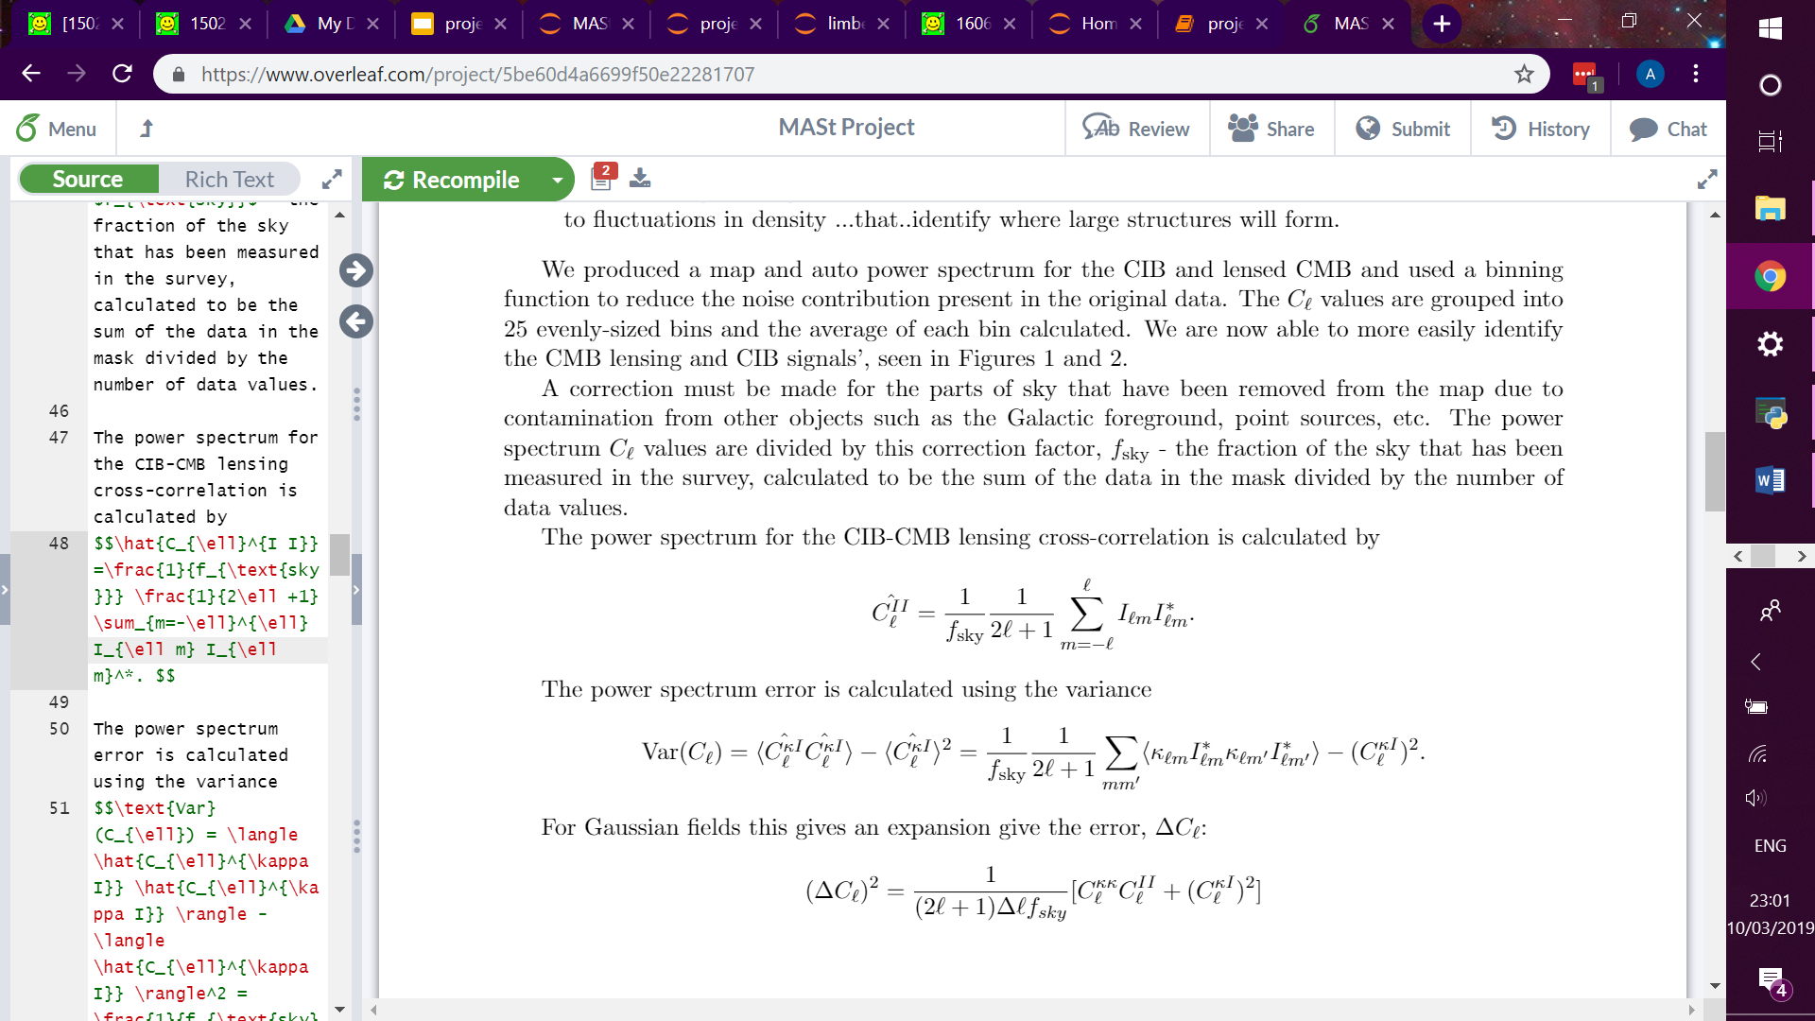
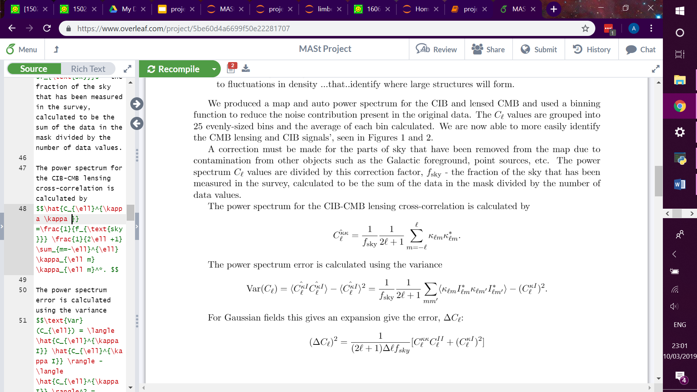
CIB and CMB Lensing auto spectra

Slide 11
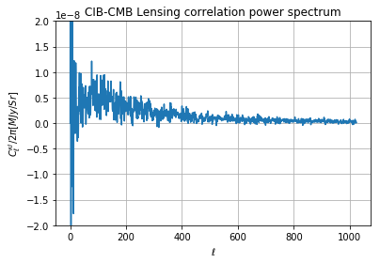
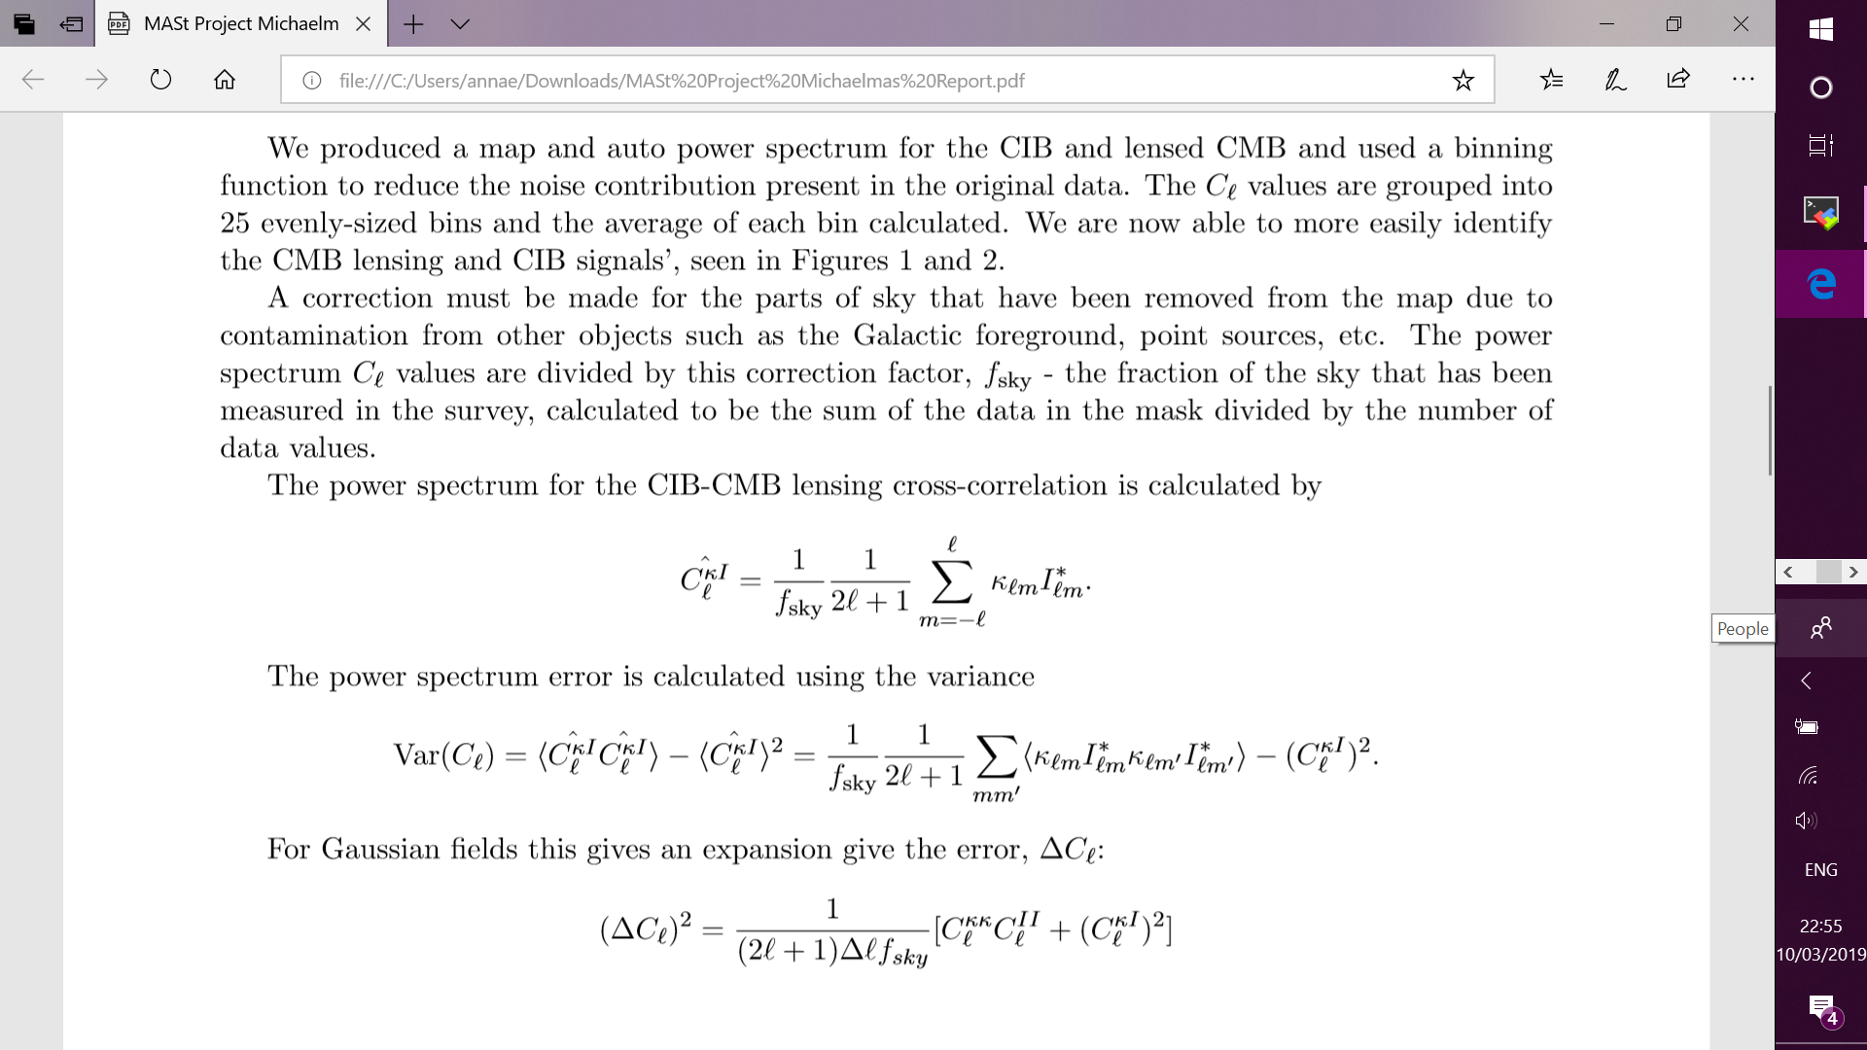
CIB – CMB-lensing Cross Correlation

Slide 12
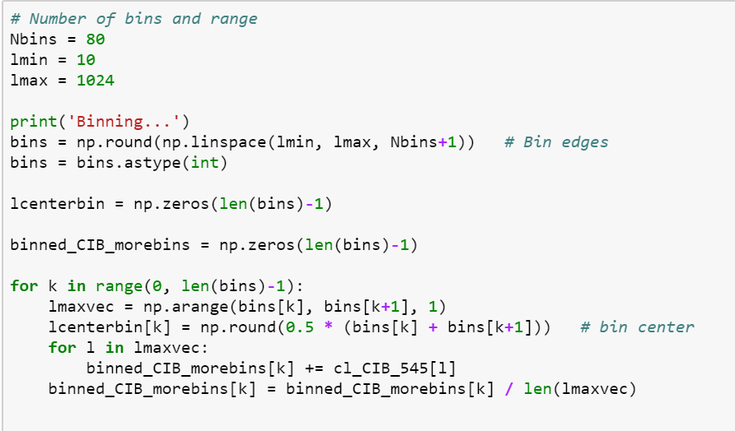
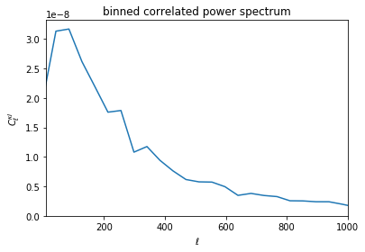
Binning

Slide 13
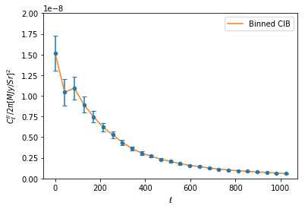
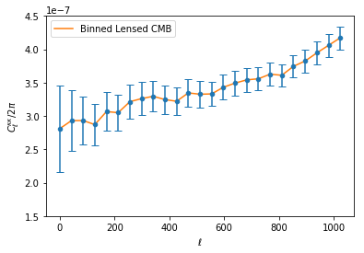
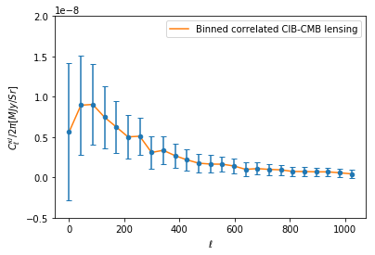
Errors

Slide 14
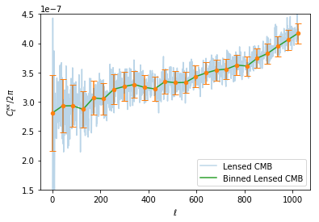
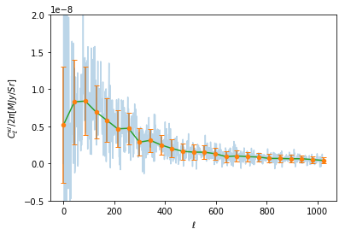
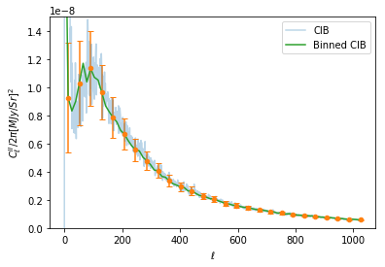
End of Michaelmas Term

Slide 15
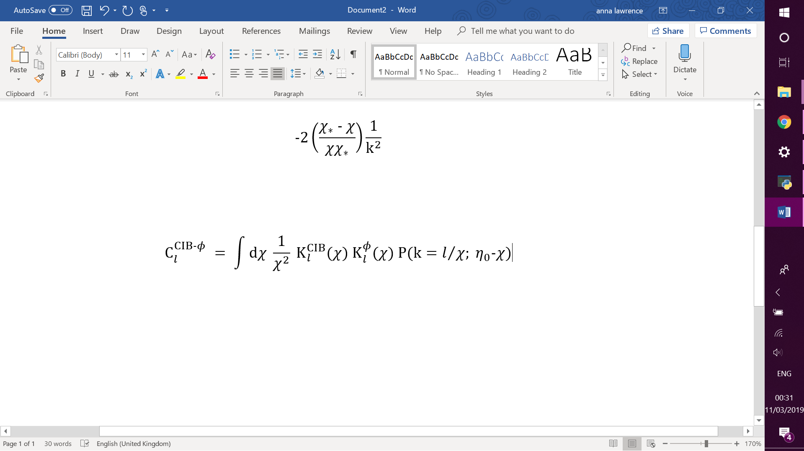
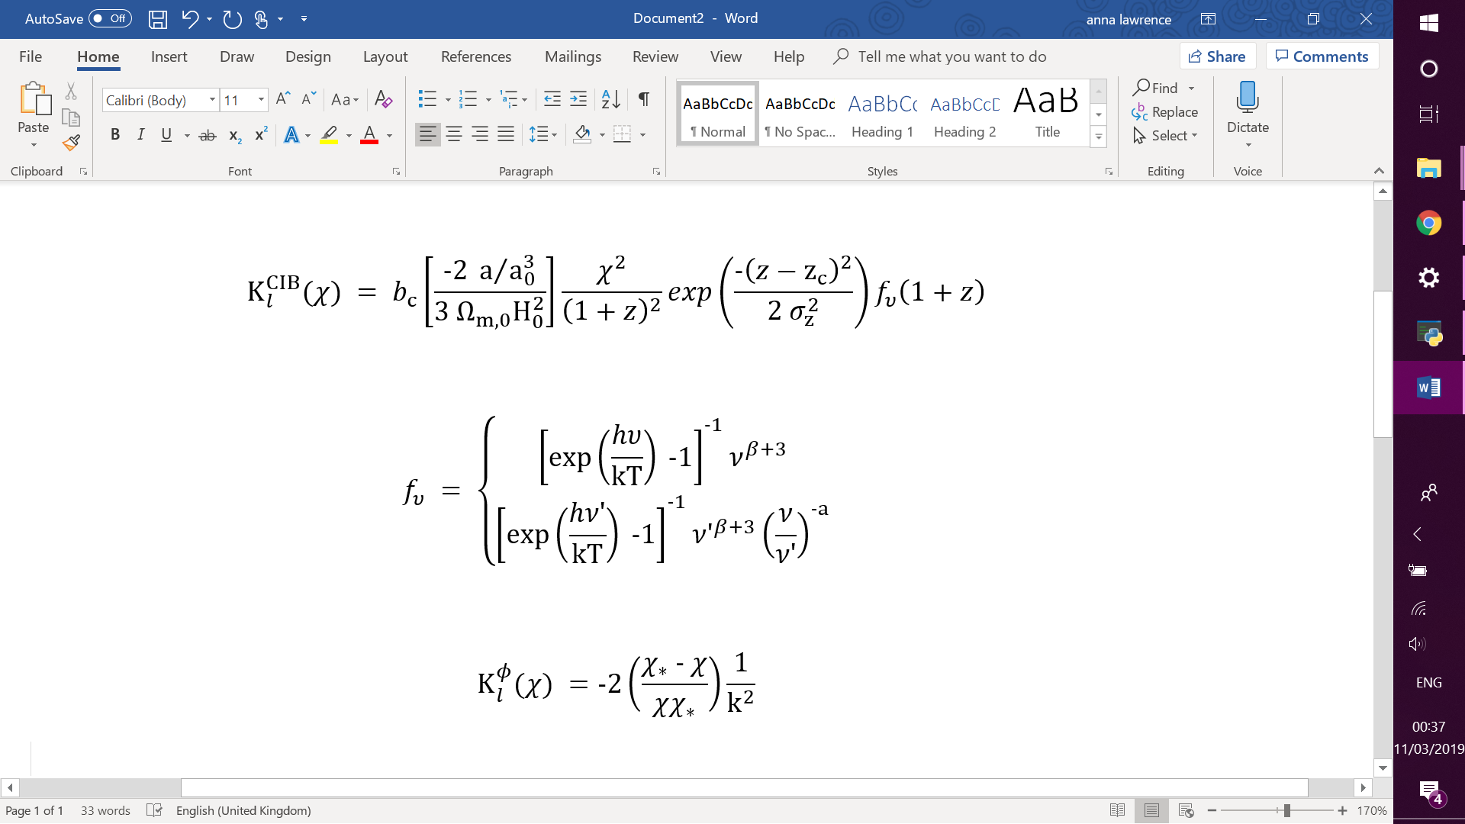
Adding theoretical predictions
Appendix D: CIB Model
Planck 2015 Results XV. Gravitational Lensing

Slide 16
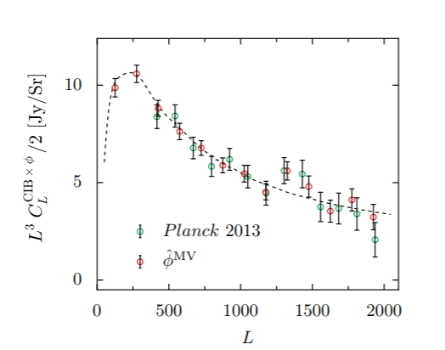
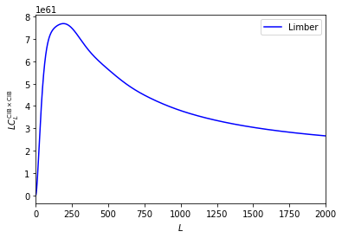
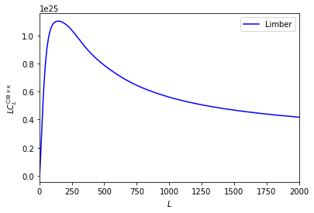
Appendix D: CIB Model
Planck 2015 Results XV. Gravitational Lensing

Slide 17
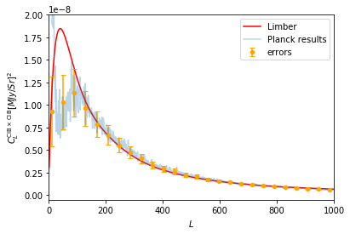
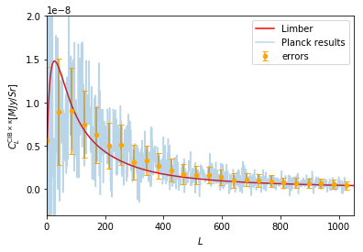
Fitting theory to data

Slide 18
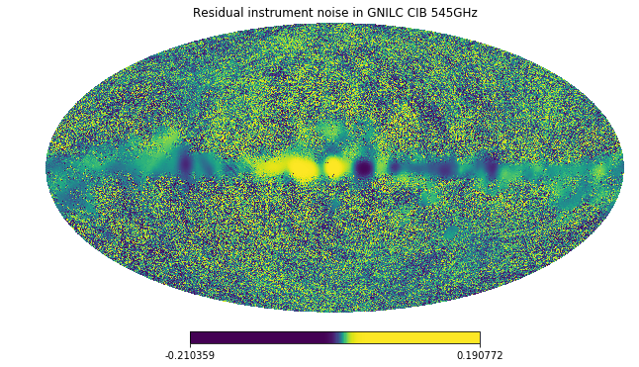
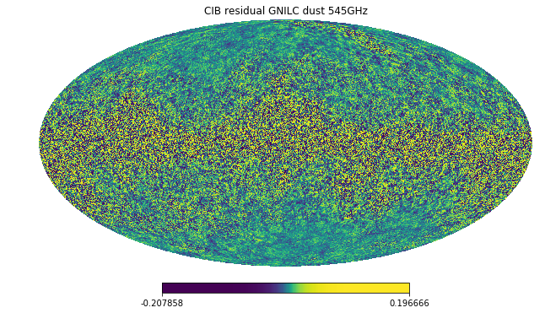
CIB GNILC residuals
NOISE_residual_gnilc_dust_F545.fits.gz
CIB_residual_gnilc_dust_F545.fits.gz

Slide 19
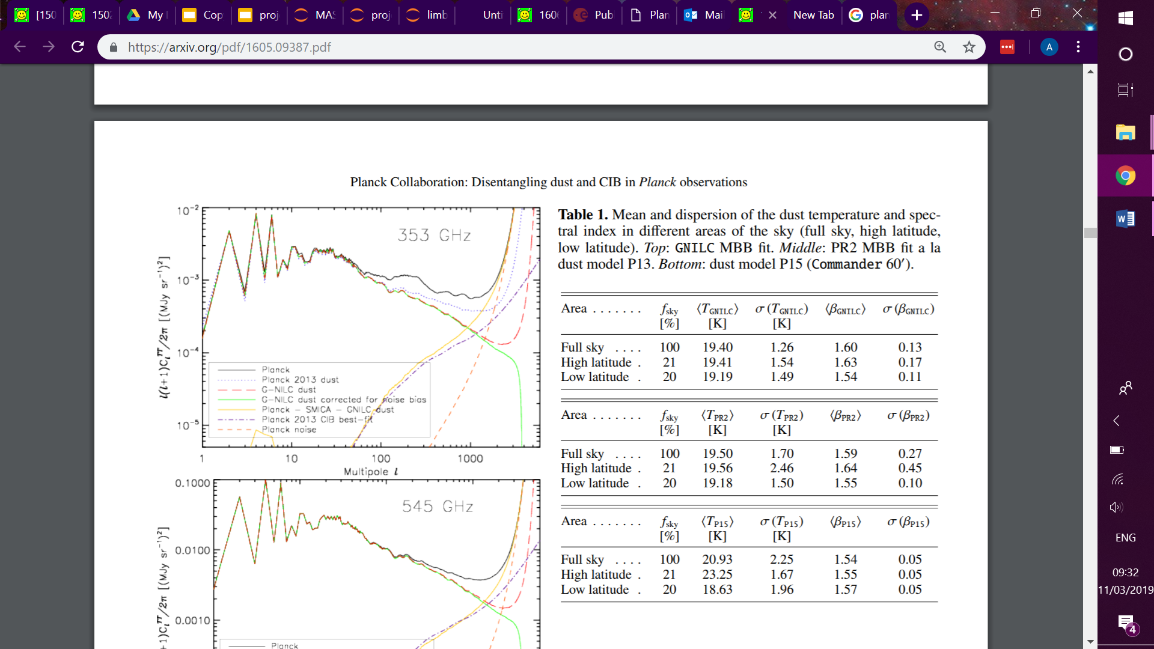
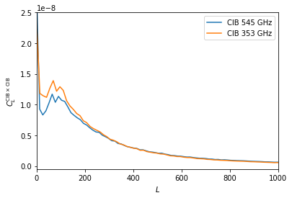
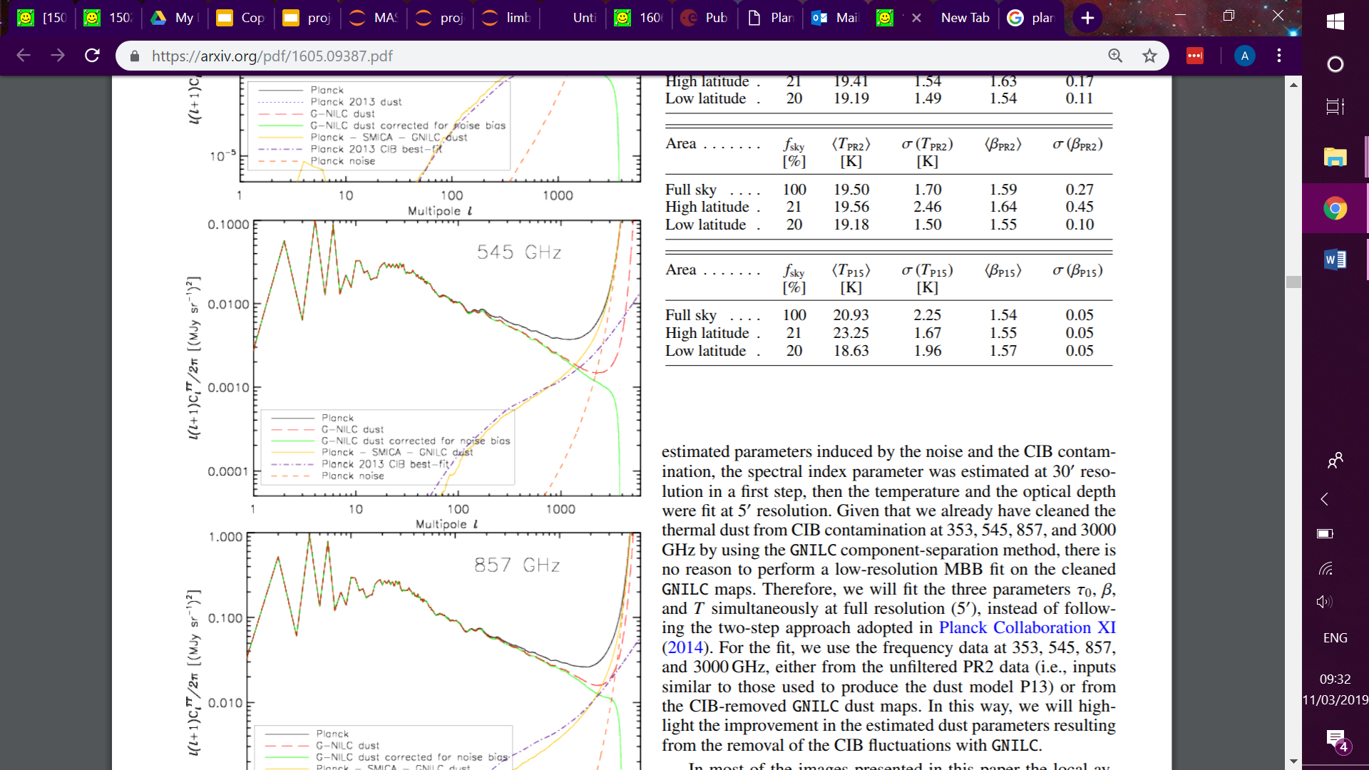
Planck intermediate results. XLVIII. Disentangling Galactic dust emission and cosmic infrared background anisotropies
Planck Collaboration, 2016

Slide 20
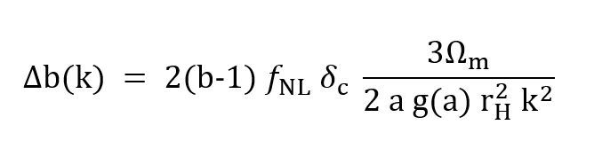
Adding scale dependent bias
Local NG generates a scale-dependent correction to the bias of galaxies and halos, of the form
The imprints of primordial non-gaussianities on large-scale structure: scale dependent bias and abundance of virialized objects
Dalal et al, 2008

Slide 21
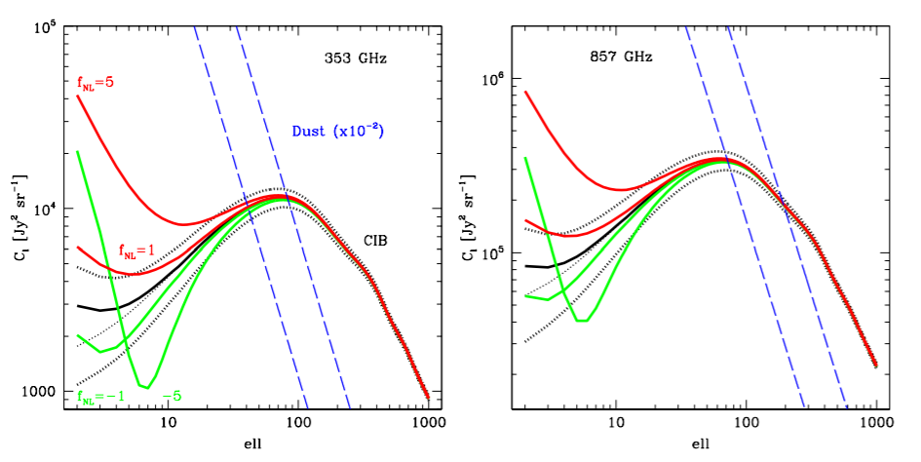
CIB power spectra (including GR corrections) at 353 and 857 GHz assuming Gaussian primordial fluctuations (black solid lines) and fNL = ±1 and ±5 (solid red and green lines)
Cosmic Infrared Background anisotropies as a window into primordial non-Gaussianity
Tucci et al, 2016

Slide 22
Conclusions
Have successfully produced maps, auto power spectra for CIB and Lensed CMB and a power spectrum showing a correlation of the two signals.
Have carried out a Limber approximation to produce theoretical CIB and CMB Lensing spectra and correlated power spectrum.
Working towards including the scale dependent bias factor, b, induced by primordial non-Gaussianity.

Slide 23
To do...
Compare theoretical power spectrum with added bias term to Tucci et al, 2016
Fit the theoretical power spectrum to the Planck data using Limber approximation as seen today with additional shot noise and instrument noise terms.

